Slide 1
Database Management Systems
Notes:
Covered in ?

Slide 2
outline
Relational Data Model
Basic Terminology
Mathematical Definition of a Relation
Relational Keys
Integrity Constraints

Slide 3
Data Model – a recap
Helps to understand the complexities of the real-world environment.
reduces the complexities of database design to more easily understood abstractions that define entities and the relations among them.
Represents data structures and their characteristics, relationships, constraints, transformations, and other constructs with the purpose of supporting a specific problem domain.

Slide 4
Components of a data model - a recap
A data structure that will store the end-user data.
A set of enforceable rules to guarantee the integrity of the data.
A data manipulation methodology to support the real-world data transformations.

Slide 5
Building blocks of a data model – a recap
Entities
Attributes
Relationships
Constraints

Slide 6
Terminology of relational data model
A relation is a table with columns and rows.
Only applies to logical structure of the database, not the physical structure.
Attribute is a named column of a relation.
Domain is a set of allowable values for one or more attributes.
Tuple is a row of a relation.
Degree is a number of attributes in a relation.
Cardinality is a number of tuples in a relation.
Relationship is a link or dependency between relations.
Relational Database is a collection of relations.

Slide 7
Terminology
A relation is a table with columns and rows.
A table can be written as
STUDENT(ID, Name, CNIC, DOB, DeptCode)
Relation name
Columns or Attributes
t₂[DOB]
STUDENT: R
ID NAME CNIC DOB DEPTCODE
201111 KHALED 1111111111 16-05-1984 ICS
202222 ADEL 2222222222 23-09-1984 COE
203333 AHMED 3333333333 11-08-1984 COE
211111 HASSAN 4444444444 23-10-1985 SWE
204444 MUSTAFA 55555555555 16-11-1984 ICS
Rows or Tuples
r(R)
Cardinality
Degree

Slide 8
Characteristics of Relations
Each relation in the same relational database schema has a distinct name
Each value in a tuple is atomic
Each attribute in a relation has a distinct name.
Values of an attribute are all from the same domain.
Each tuple is distinct.
Order of attributes has no significance.
Order of tuples has no significance.

Slide 9
Relational Data Model Notations
The letters Q, R, S denote the abstract relation names.
R(A1, A2, A3, …., An) denotes a relational schema R of degree n.
Example: STUDENT(RollNo, Name, Phone, Address, Mobile, DOB)
COURSE(CourseID, Title, CreditHours)
Both t[Ai] and t.Ai refers to the value vi in t for attribute Ai
Example: in second tuple, both t[name] and t.name refers to “Adel”
Dom(DEPTCODE) = {‘COE’,’ICS’,’SWE’}

Slide 10
Mathematical definition of a Relation
Relation: A relation is a subset of Cartesian product of all domains
R(r) ⊆ Dom(A1) x Dom(A2) x …… x Dom(An)
Where A1, A2, …., An represent attributes of a relation r.
Evaluation:
Given
A1 = {1, 2}, A2 = {a}, A3 = {x, y}
Then relation
X = {(1, a, y), (2, a, x), (2, a, y)}; 3 tuples of a relation
is a subset of
Y = Dom(A1) x Dom(A2) x Dom(A3)
= {(1, a, x), (1, a, y), (2, a, x), (2, a, y)}
Note: Degree of a relation is the number of attributes, in above case degree of relation is 3.

Slide 11
Example – Relational Analysis
Evaluate Cartesian product of the following relations A & B:
1 2 3 a b c
A = 4 5 6 B = x y z
7 8 9
1 2 3 a b c
1 2 3 x y z
4 5 6 a b c
A x B= 4 5 6 x y z
7 8 9 a b c
7 8 9 x y z

Slide 12
Another Example: Cartesian Product
Ordered Pair: An ordered pair is a pair of objects where one element is designated first and the other element is designated second, denoted (a, b).
Cartesian Product: The Cartesian product of two sets A and B, denoted A × B, is the set of all possible ordered pairs where the elements of A are first and the elements of B are second.
In set-builder notation, A × B = {(a, b) : a ∈ A and b ∈ B}.
Example: Let A = {H, T} and B = {1, 2, 3, 4, 5, 6}.
A × B = {(H, 1), (H, 2), (H, 3), (H, 4), (H, 5), (H, 6), (T, 1), (T, 2), (T, 3), (T, 4), (T, 5), (T, 6)}
B × A = {(1, H), (2, H), (3, H), (4, H), (5, H), (6, H), (1, T), (2, T), (3, T), (4, T), (5, T), (6, T)}

Slide 13
Keys
A key is a combination of one or more columns that is used to identify rows in a relation
A composite key is a key that consists of two or more columns
Purpose
Ensure that each row in a table is uniquely identifiable.
Establish relationships among tables
Ensure the integrity of the data
Notes:
Differentiating record from other records based on columns called Key-columns.
When some one is searching account balance through CNIC when account no is not provided.
On search two account nos will be appeared, one is single and other is joint account. A situation is raised, exactly which record of balance is needed. Such kind of issues
will be discussed in this chapter.

Slide 14
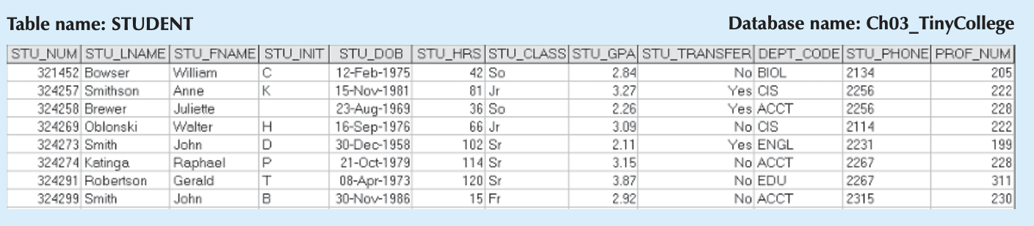
Key as a determinant
A key’s role is based on a concept known as determination
Example
“A determines B” indicates that if you know the value of attribute A, you can look up (determine) the value of attribute B.
using the STU_NUM in the STUDENT table you are able to look up (determine) that student’s last name, grade point average, phone number, and so on

Slide 15
Key as a determinant - shorthand
The shorthand notation for “A determines B” is A → B
If A determines B, C, and D, you write A → B, C, D
Examples from Student Table
STU_NUM → STU_LNAME
STU_NUM → STU_LNAME, STU_FNAME, STU_INIT

Slide 16
Key as a determinant - shorthand
Quiz !!!
Can STU_LNAME → STU_NUM
Solution: No, since it is quite possible for several students to have the same last name
*Concept of Determination is very important for Functional Dependencies which we will see later in detail

Slide 17
Types of Keys
Super Key
Candidate Key
Primary Key
Alternate Key
Foreign Key
Surrogate Key

Slide 18
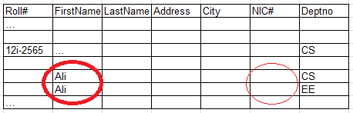
Super Key
An attribute, or set of attributes, that uniquely identifies a tuple within a relation.
i.e. it determines all of a row’s attributes
Example
Possible Super Keys
{Roll#},
{Roll#, NIC#},
{NIC#}
{Roll#, FirstName, LastName}
{Roll#, FirstName, LastName, Address, City, NIC#, Deptno}
Can be a super Key ?
Notes:
{Roll#} is Super Key but {FirstName, LastName} is not Super Key because many students have same name.
{Roll#, FirstName, LastName} is a Super Key because Roll# will be distinct for any same or distinct name.
A super key is defined as a set of attributes of a relation for which it holds that in all relations assigned to that variable there are no two distinct tuples (rows) that have the same values for the attributes in this set.
Roll numbers of Ali exist but we do not know. NIC may exist or not. Then how to decide who is exact Ali looking for, belongs to CS or EE

Slide 19
Another Example
Roll Number | First Name | Last Name
CSU0001 | Shabbir | Khan
CSU0002 | Aslam | Bhai
CSU0003 | Irfan | Ali
Now we have the following as super keys
Roll Number | First Name
Roll Number | First Name | Last Name

Slide 20
Candidate Key
Definition
A candidate key can be described as a Super Key without unnecessary attributes, that is, a minimal Super Key

Slide 21
Candidate Key - Example
Example Super Keys
STU_NUM
STU_NUM, STU_LNAME
STU_NUM, STU_LNAME, STU_INIT

Slide 22
Candidate Key - Quiz
Is “STU_NUM, STU_LNAME” a Candidate Key ?
No, because STU_NUM by itself is a candidate key
Recall from previous slide (Added Information):
Candidate Key is a Superkey (K) such that its no proper subset is a superkey within the relation.
But STU_NUM is its subset and is a SuperKey
No proper subset of Superkey has the uniqueness property (irreducibility).
But STU_NUM is its subset and posses uniqueness property

Slide 23
Benefit of Candidate Key
Searching Student’s Record
Your Parents may not know your Roll # but using your first-name and last-name (a candidate key), fewer search records will be retrieved from the system
But Roll # is one of the candidate key, it gives exact record if known
Search account details in a Bank
Account holder goes to a bank without taking his/ her account number
Account information will be retrieved with the help candidate keys
Notes:
Ask you father and mother, do they know your roll#. They cannot not remember. If they come or contact university to get your information such as progress or status of your study. Your credentials and study details will be retrieved with the help candidate keys. Candidate key will help to find an exact record from fewer searched records. Roll# is one of the candidate key, it gives exact record if known.
Similarly, account holder goes to a bank without taking his/ her account number. Account information will be retrieved with the help candidate keys. Search by name is not possible because it contains many records and name can be saved with different spelling. Also, search with name will be very slow.
CNIC→ Null, OK, Not correct. If OK then two accounts may exist Single and joint. Which account’s balance is required
A person (with CNIC known) who has taken insurance for his two daughters (their CNIC is unknown) twenty years ago. Person is passed away and his wife wants to acquire information about insurance of daughters. Note that Wife does not has policy#.
How do you manage the concept of candidate key. Give table(s) with column names to track exact records of both daughters for information about insurance.

Slide 24
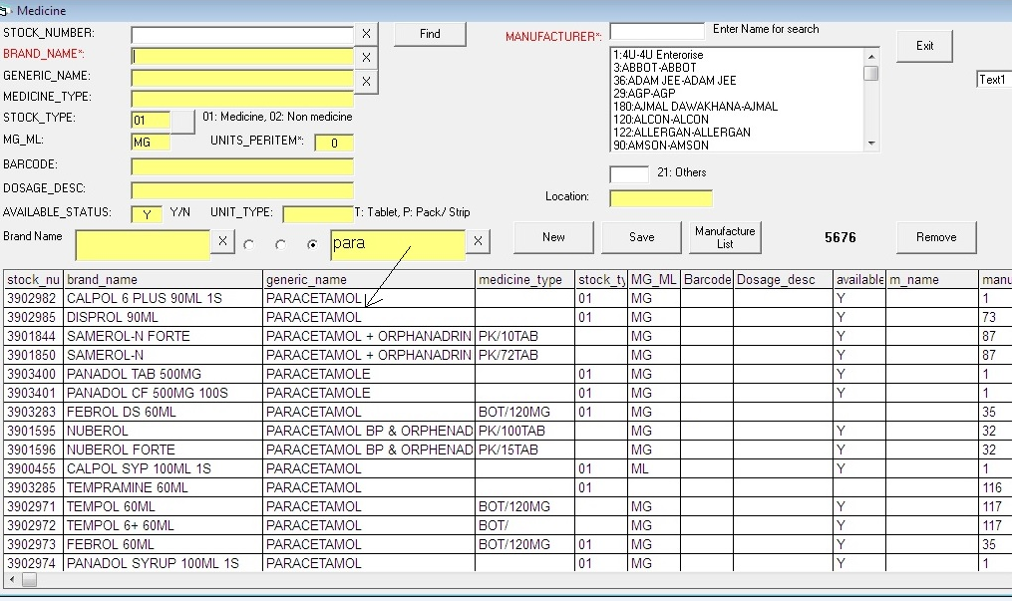
Candidate Key during search
DBA can create Index on searching attributes (candidate Keys) for faster retrieval

Slide 25
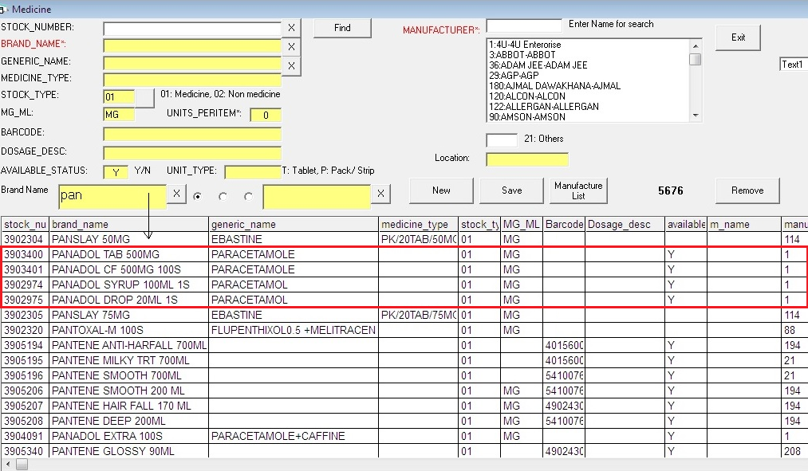
Candidate Key during search …

Slide 26
Primary Key
A candidate key selected as the primary means of identifying rows in a relation:
There is one and only one primary key per relation
The primary key is NOT NULL and UNIQUE
The ideal primary key is short, numeric(alpha), indexed, fixed length and never changes
Key that has its ownership of an Enterprise
The primary key may be a composite key

Slide 27
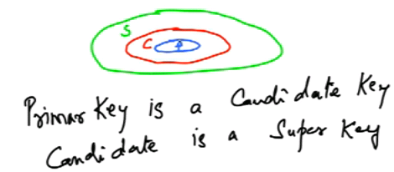
Primary Key - Quiz
Is Primary Key a Super Key ?
Yes !!!
a primary key is a superkey as well as a candidate key.

Slide 28
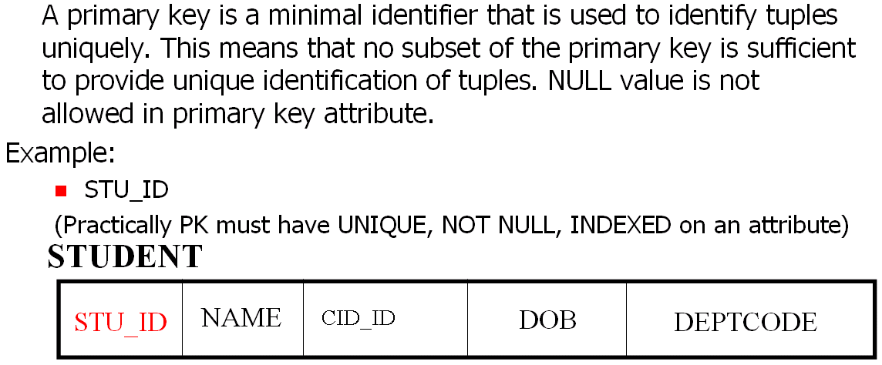
Primary Keys cont….

Slide 29
Primary Keys cont….
PK is a property of an organization.
Driving license# is a property of Ministry of Motors/ transportation,
It must not be used PK in university or other organizations. It can be a candidate key for other organization for search purposes.

Slide 30


Primary Key - Samples
512235665 Social Security Number
610112654 (By Birth Asian, Europian, HomeLand)
200338900 Student ID (With Registration year)
DMM051 Product ID (with Manufacturing Loc, branches)
JUB004
312668852369 Bank Account# (followed by Branch Code)
100211 SKU# (By Category) or a barcode
300411
Serial# Serial# starts with 1 and incremented by 1
005384 Company has many branches with code 005, 007 etc.,
007004 invoices issued from branches are recognized with branch codes

Slide 31
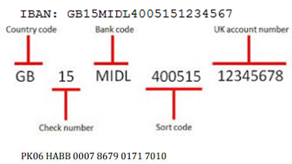
IBAN - Fixed Length another example

Slide 32
Quiz !!!
Recall from the Definition of Primary Key
The primary key is NOT NULL and UNIQUE
What is Difference between Primary Key and Unique Key ?

Slide 33
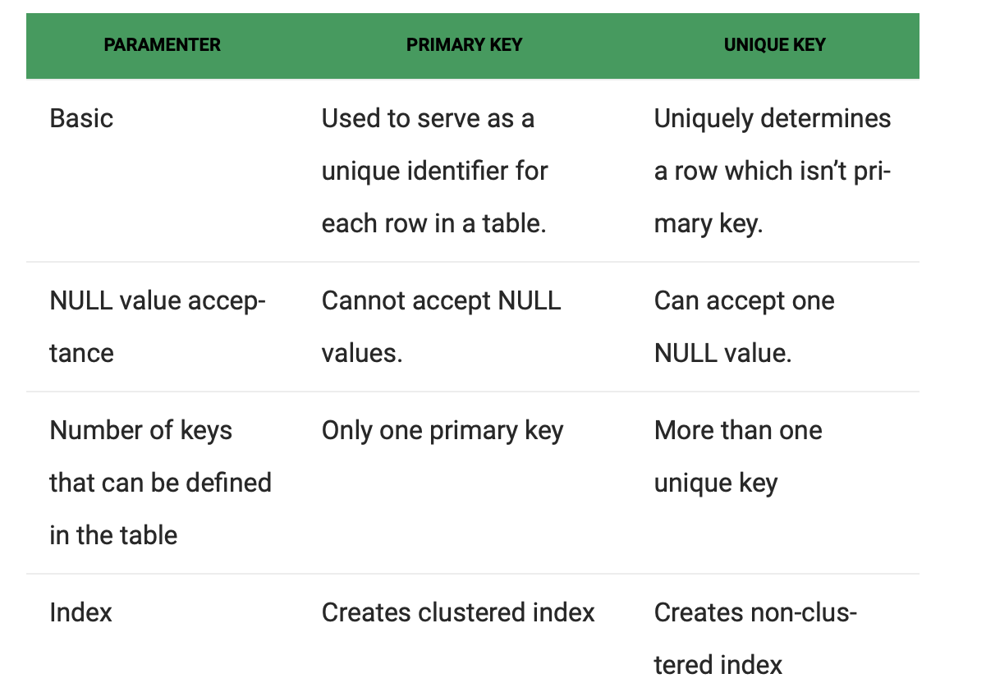
Primary Key vs Unique Key

Slide 34
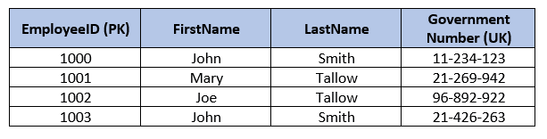
Primary Key vs Unique Key - Example
PK: Employee ID
Unique Key: GovernmentNumber
To enforce additional unique conditions on the columns
Why not just use GovernmentNumber as the primary key?
GovernmentNumber is generated by another organization outside your database
Observation
the primary key is a synthetic value such as an identity value (sequence), therefore, an naturally occurring unique values, such as Account Numbers become candidates for unique keys.

Slide 35
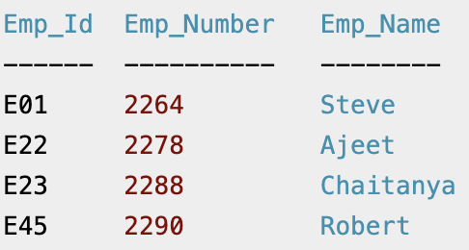
Alternate/Secondary Key
Candidate keys that are not selected to be primary key.
Candidate keys
{Emp_Id} {Emp_Number}
Selected Primary Key
Emp_Id
Remaining Candidate Key is Alternate/Secondary Key
Emp_Number
Source: https://beginnersbook.com/2015/04/alternate-key-in-dbms/

Slide 36
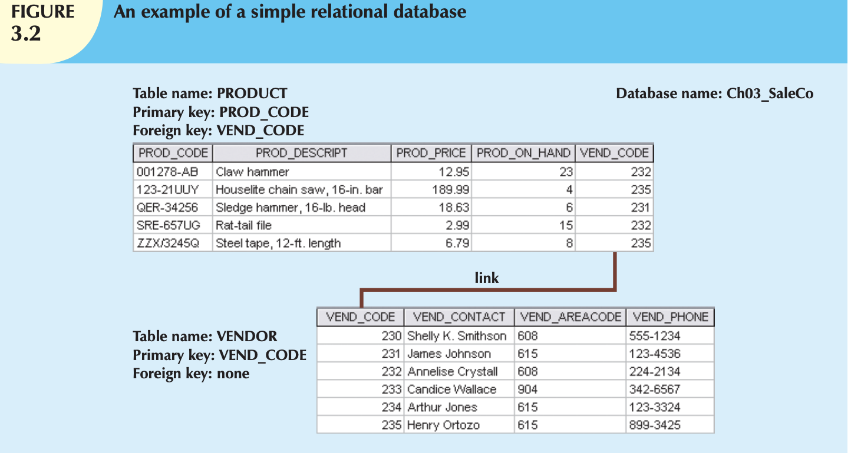
Foreign Key
An attribute whose values match the primary key values in the related table.
Showing Keys in Relational Schema
VENDOR (VEND_CODE, VEND_CONTACT, VEND_AREACODE, VEND_PHONE)
PRODUCT (PROD_CODE, PROD_DESCRIPT, PROD_PRICE, PROD_ON_HAND, VEND_CODE)
Data type, Length/ Size of FK and referring PK must be same

Slide 37
Foreign Key (FK)
An attribute (or combination of attributes) in one table whose values must either match the primary key in another table or be null.
When an FK is null ?
Either the value in parent table is not defined yet
Or the value in parent table is deleted

Slide 38
Foreign Key
Can a foreign key is an attribute that refers to primary key of same relation ?
Yes, for recursive relationship
Example of Recursive Relationship

Slide 39
Surrogate Key
A surrogate key as an artificial column added to a relation to serve as a primary key:
DBMS supplied
Short, numeric and never changes – an ideal primary key!
Has artificial values that are meaningless to users
Normally hidden in forms and reports
Notes:
Invoice is not surrogated key, although mostly it is meaningless to customers. In business or finance discipline, invoice is a well defined key column for purchasing any item. Surrogated key is mostly introduce in child transactional tables. Later it is an implementation with identifying & Weak ER.
Star Wedding Hall: EventDate, TimeStart, TimeEnd, RoomVenue, EventName, #ofPersons
What will be a PK or surrogated key for these collection of columns.

Slide 40
Surrogate Keys cont….
RENTAL_PROPERTY without surrogate key:
RENTAL_PROPERTY with surrogate key:
RENTAL_PROPERTY (PropertyID, Street, City,
State/Province, Zip/PostalCode, Country, Rental_Rate)
RENTAL_PROPERTY (Street, City, State/Province, Zip/PostalCode, Country, Rental_Rate)

Slide 41
Surrogate Key – As Another example
ATM card is being used in machine to draw some amount as a transaction.
Attributes are
Card#, Amount, DrawDate
However,
Card# will be used many times
Introduce a column as a Surrogate Key
ATMTransaction (Card#, Serial#, Amount, DrawDate)

Slide 42
Integrity Constraints/Rules
Entity Integrity
Referential Integrity
Null
Domain Constraint
Additional Constraint

Slide 43
Entity Integrity
All primary key entries are unique
No two rows with the same primary key value
No part of a primary key maybe null
No null values in a primary key
Example
No invoice can have a duplicate number, nor can it be null. In short, all invoices are uniquely identified by their invoice number.

Slide 44
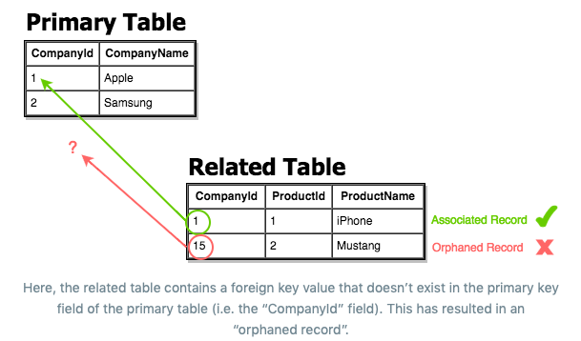
Referential Integrity
Data is linked between two or more tables
by having the foreign key (in the associated table) reference a primary key value (in the primary table).
Because of this, we need to ensure that data on both sides of the relationship remain intact.
Referential integrity refers to the accuracy and consistency of data within a relationship.
whenever a foreign key value is used it must reference a valid, existing primary key in the parent table.

Slide 45
Benefits of Referential Integrity Constraint
It will prevent users from
Adding records to a related table if there is no associated record in the primary table.
Changing values in a primary table that result in orphaned records in a related table.
Deleting records from a primary table if there are matching related records.

Slide 46
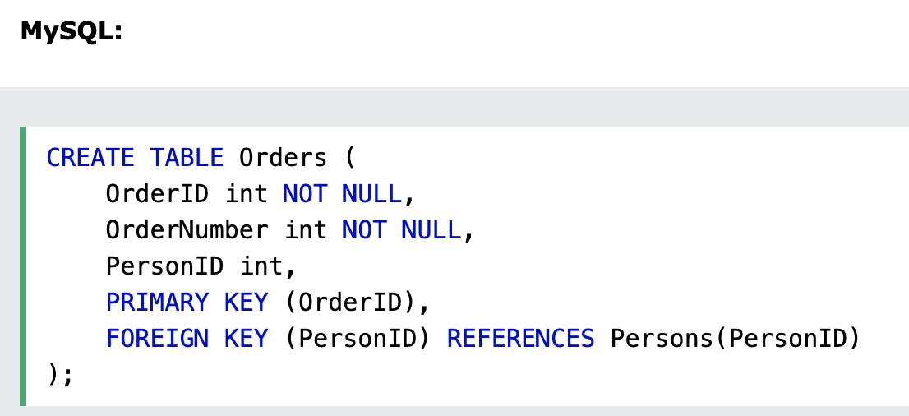
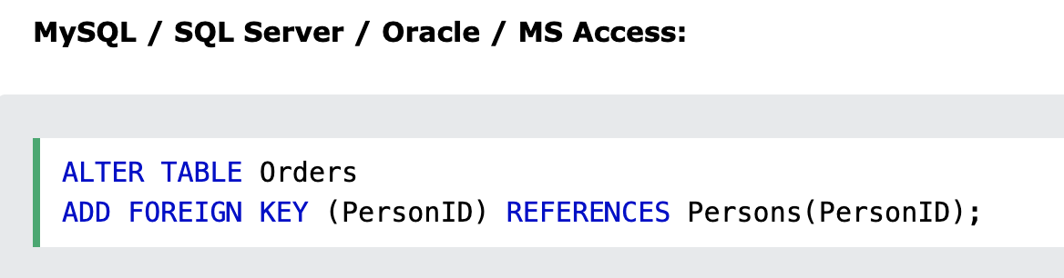
PK and FK in SQL: Example

Slide 47
On Delete Clause in Foreign Key Constraint
CASCADE
if the parent record is deleted, any child records are also deleted
NO ACTION
rejects the delete or update operation for the parent table if there is a related foreign key value in the referenced table.
SET NULL
Delete or update the row from the parent table, and set the foreign key column or columns in the child table to NULL
SET DEFAULT
Allows the developer to specify a value to which to set the foreign key column(s) on an UPDATE or a DELETE

Slide 48
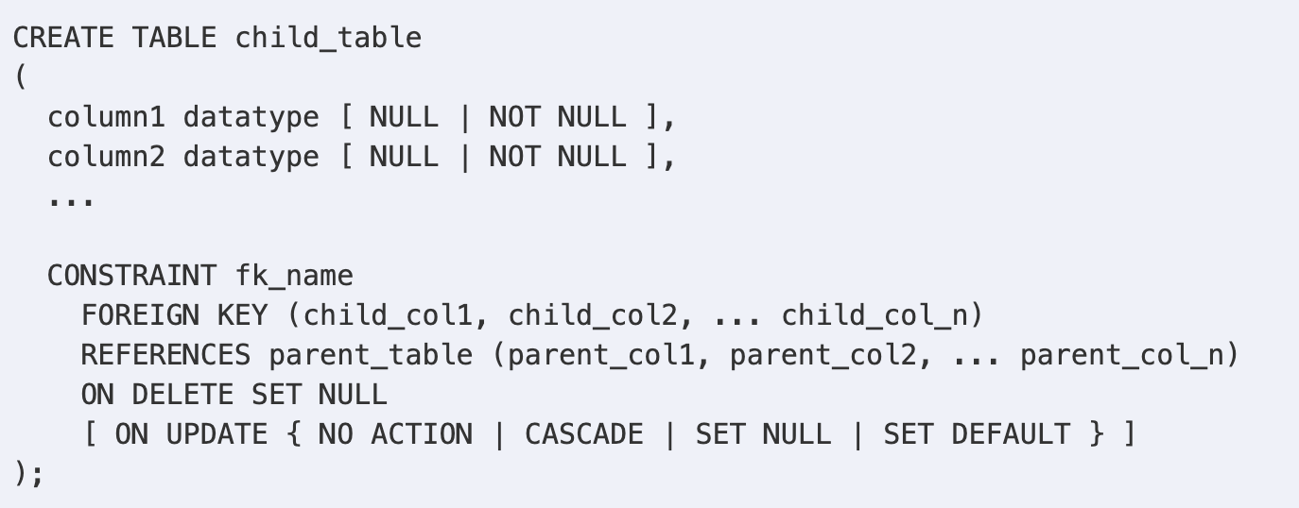
Syntax

Slide 49
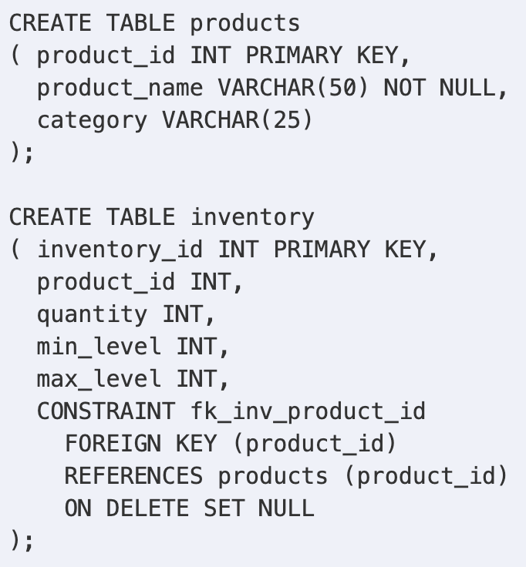
Example

Slide 50
Domain Constraint
To allow a valid set of values for an attribute
Example
an hourly-wage domain allows only values greater than a specified value.
The check clause in SQL permits domains to be restricted:
Use check clause to ensure that an hourly-wage domain allows only values greater than a specified value.

Slide 51
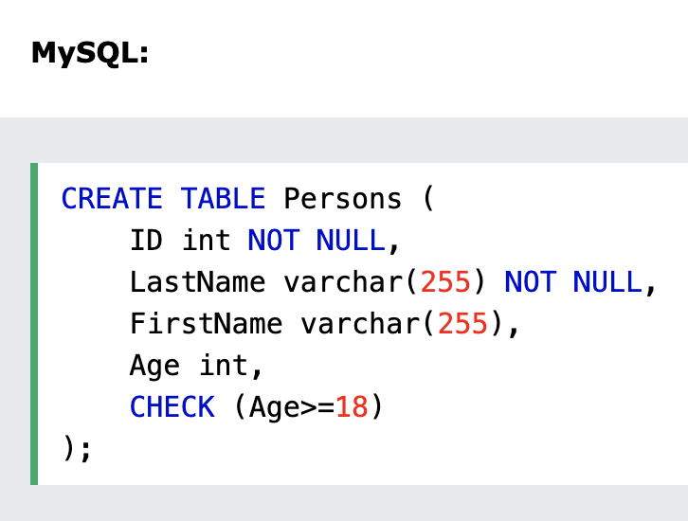
Example

Slide 52
Attribute Constraint
An attribute constraint is a declaration to the effect that a specified attribute is of a specified type.
Any attempt to introduce an attribute value into the database that is not a type of the relevant type will simply rejected.
Example
Storing name in Attribute of Roll #

Slide 53
Table Constraint
A table constraint is a constraint on an individual table.
Example:
PRIMARY KEY Specifies the column or columns that uniquely identify a row in the table. NULL values are not allowed.
UNIQUE Specifies that values in the columns must be unique.
FOREIGN KEY Specifies that the values in the columns must correspond to values in referenced primary key or unique columns or that they are NULL.
Note: If the foreign key consists of multiple columns, and any column is NULL, the whole key is considered NULL.
CHECK Specifies a wide range of rules for values in the table.

Slide 54
Null
A null is no value at all.
It does not mean a zero or a space
a null (that is, no data entry at all) is not permitted in the primary key
Nulls, if used improperly, can create problems because they have many different meanings
An unknown attribute value.
A known, but missing, attribute value.
A “not applicable” condition.

